Slide 1
Decision Tree

Slide 2
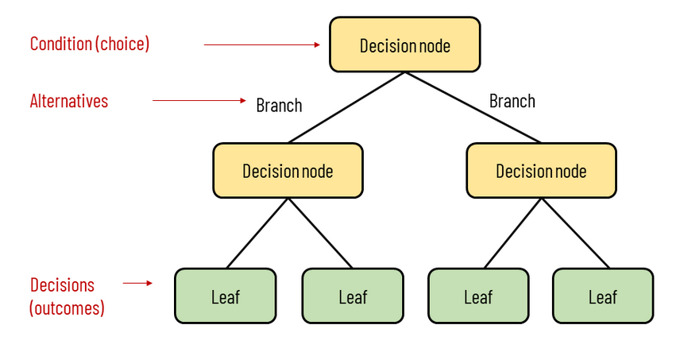
What is Decision Tree
Decision Tree
Decision Tree (DT) is information based, a non-parametric supervised learning method.
It predicts the value of a target variable, by learning simple decision rules inferred from prior data(training data)
It has a hierarchical, tree structure, which consists of a root node, branches, internal nodes and leaf nodes.
The deeper the tree, the more complex the decision rules and the fitter the model..
non-parametric: Attributes not required to follow any probability distribution (Normal Distribution)

Slide 3
How Decision Tree Works
It begins with the original set S as the root node.
Split the Original set according to each attribute and calculate Entropy and Information gain .
Then select the attribute which has the smallest Entropy or Largest Information gain.
The set S is then split by the selected attribute to produce a subset of the data.
The algorithm continues to Split on each subset.
A branch with an entropy of zero is a leaf node no Splitting further and a branch with entropy more than zero needs further splitting.
Alternative of Entropy are Gini index(Classification), Chi-Square (Classification) Reduction in Variance(Regression),
Gain Ratio is alternative of information gain takes care for categories in attribute

Slide 4
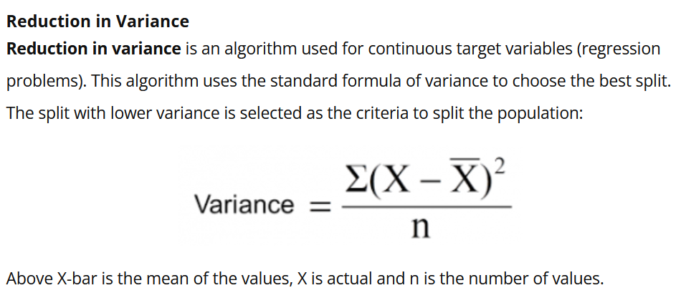

Slide 5

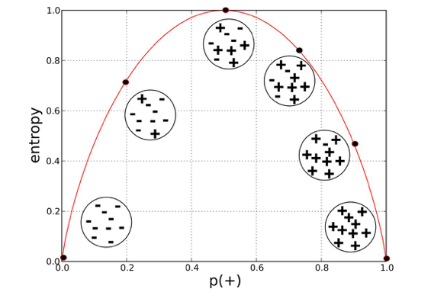
Entropy
Decision Tree
Entropy is measure of impurity of data. Entropy for Pure sample(P=1) is zero and also zero for class whose probability is 0. Impurity is a measure of the homogeneity of the labels on a node.
More the probability of occurrence lesser the impurity. Impurity = 1/P, to get zero entropy for pure class we take log, log(1/P) and log rules becomes -log(P)
The Entropy for data have two classes only (+, -)
To calculate Total Entropy according to Attribute
we aggregate using weighted average
14
RBEI/EDS1-PJ-AI-S2 | 2018-07-06
© Robert Bosch Engineering and Business Solutions Private Limited 2018. All rights reserved, also regarding any disposal, exploitation, reproduction, editing, distribution, as well as in the event of applications for industrial property rights.

Slide 6
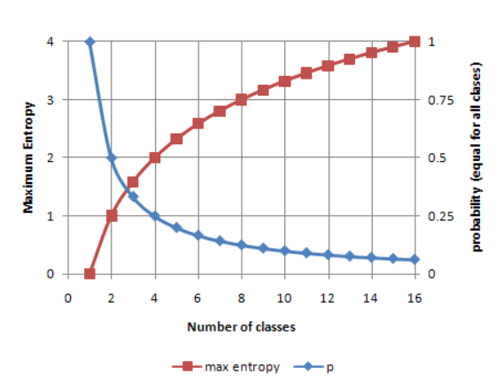
Decision Tree
Entropy
When number of class increases Total Entropy value also increases, if we have 2 classes maximum entropy will be 1, if we have 4 classes maximum entropy will be 2. And so on.
When all classes have equal probability, the individual probability decreases when class increases.
Value of Information gain also increases if number of class increases.

Slide 7

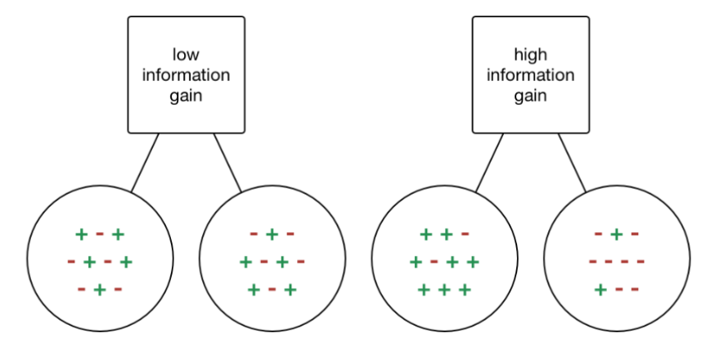
Decision Tree
Information Gain
Information gain or IG is a statistical measures how well a given attribute separates the training examples according to their target classification.
More the Information gain better we can explain/predict according to Split variable X.
Value of Information gain increases if number of classes increases

Slide 8
Decision Tree
Entropy Calculation
Predict if John will Play Tennis or not play given Outlook, humidity, Wind.
Day | Outlook | Humidity | Wind | Play
D1 | Sunny | High | Weak | No
D2 | Sunny | High | Strong | No
D3 | Overcast | High | Weak | Yes
D4 | Rain | High | Weak | Yes
D5 | Rain | Normal | Weak | Yes
D6 | Rain | Normal | Strong | No
D7 | Overcast | Normal | Strong | Yes
D8 | Sunny | High | Weak | No
D9 | Sunny | Normal | Weak | Yes
D10 | Rain | Normal | Weak | Yes
D11 | Sunny | Normal | Strong | Yes
D12 | Overcast | High | Strong | Yes
D13 | Overcast | Normal | Weak | Yes
D14 | Rain | High | Strong | No
Play (Yes) | Play (No)
9 | 5
Total = 14 Records
Entropy (Play) = - (9/14)*log(9/14)- (5/14)*log(5/14)
Entropy(Play) = 0.94

Slide 9
Decision Tree
Entropy, Information Gain Calculation according to Humidity
Day | Outlook | Humidity | Wind | Play
D1 | Sunny | High | Weak | No
D2 | Sunny | High | Strong | No
D3 | Overcast | High | Weak | Yes
D4 | Rain | High | Weak | Yes
D5 | Rain | Normal | Weak | Yes
D6 | Rain | Normal | Strong | No
D7 | Overcast | Normal | Strong | Yes
D8 | Sunny | High | Weak | No
D9 | Sunny | Normal | Weak | Yes
D10 | Rain | Normal | Weak | Yes
D11 | Sunny | Normal | Strong | Yes
D12 | Overcast | High | Strong | Yes
D13 | Overcast | Normal | Weak | Yes
D14 | Rain | High | Strong | No
Humidity | Play (Yes) | Play (No) | Total
High | 3 | 4 | 7
Normal | 6 | 1 | 7
Entropy(Play|Humidity=High) = -(3/7)*log(3/7)- (4/7)*log(4/7)
Entropy(Play|Humidity=High)= 0.98
Entropy(Play|Humidity=Normal)= -(6/7)*log (6/7)-(1/7)*log(1/7)
Entropy(Play|Humidity=Normal)= 0.59
Entropy(Play|Humidity)= (7/14)* Entropy(Play|Humidity=High) + (7/14)*Entropy(Play|Humidity=Normal)
Entropy(Play|Humidity)= 0.78
Information Gain = Entropy(Play) - Entropy(Play|Humidity)=
= 0.94- 0.78 = 0.16

Slide 10
Decision Tree
Entropy, Information Gain Calculation according to Wind
Day | Outlook | Humidity | Wind | Play
D1 | Sunny | High | Weak | No
D2 | Sunny | High | Strong | No
D3 | Overcast | High | Weak | Yes
D4 | Rain | High | Weak | Yes
D5 | Rain | Normal | Weak | Yes
D6 | Rain | Normal | Strong | No
D7 | Overcast | Normal | Strong | Yes
D8 | Sunny | High | Weak | No
D9 | Sunny | Normal | Weak | Yes
D10 | Rain | Normal | Weak | Yes
D11 | Sunny | Normal | Strong | Yes
D12 | Overcast | High | Strong | Yes
D13 | Overcast | Normal | Weak | Yes
D14 | Rain | High | Strong | No
Wind | Play (Yes) | Play (No) | Total
Weak | 6 | 2 | 8
Strong | 3 | 3 | 6
Entropy(Play|Wind=Weak) = -(6/8)*log(6/8)- (2/8)*log(2/8)
Entropy(Play|Wind=Weak)= 0.81
Entropy(Play|Wind=Strong)= -(3/6)*log (3/6)-(3/6)*log(3/6)
Entropy(Play|Wind=Strong)= 0.30
Entropy(Play|Wind)= (8/14)* Entropy(Play|Wind=Weak) + (6/14)*Entropy(Play|Wind=Strong)
Entropy(Play|Wind)= 0.59
Information Gain = Entropy(Play) - Entropy(Play|Wind)=
= 0.94- 0.59 = 0.34

Slide 11
Decision Tree
Entropy, Information Gain Calculation according to Outlook
Day | Outlook | Humidity | Wind | Play
D1 | Sunny | High | Weak | No
D2 | Sunny | High | Strong | No
D3 | Overcast | High | Weak | Yes
D4 | Rain | High | Weak | Yes
D5 | Rain | Normal | Weak | Yes
D6 | Rain | Normal | Strong | No
D7 | Overcast | Normal | Strong | Yes
D8 | Sunny | High | Weak | No
D9 | Sunny | Normal | Weak | Yes
D10 | Rain | Normal | Weak | Yes
D11 | Sunny | Normal | Strong | Yes
D12 | Overcast | High | Strong | Yes
D13 | Overcast | Normal | Weak | Yes
D14 | Rain | High | Strong | No
Outlook | Play (Yes) | Play (No) | Total
Sunny | 2 | 3 | 5
Overcast | 4 | 0 | 4
Rain | 3 | 2 | 5
Entropy(Play| Outlook= Sunny) = -(2/5)*log(2/5)- (3/5)*log(3/5)
Entropy(Play| Outlook= Sunny)= 0.97
Entropy(Play| Outlook= Overcast)= -(4/4)*log (4/4)-(0)*log(0)
Entropy(Play| Outlook= Overcast)= 0
Entropy(Play| Outlook= Rain)= -(3/5)*log (3/5)-(2/5)*log(2/5)
Entropy(Play| Outlook= Rain)= 0.29
Entropy(Play| Outlook)= (5/14)*0.97 + (4/14)*0 +(5/14)* 0.29
Entropy(Play| Outlook)= 0.45
Information Gain = Entropy(Play) - Entropy(Play| Outlook)=
= 0.94- 0.59 = 0.48

Slide 12
Decision Tree
Entropy Calculation
Day | Outlook | Humidity | Wind | Play
D1 | Sunny | High | Weak | No
D2 | Sunny | High | Strong | No
D3 | Overcast | High | Weak | Yes
D4 | Rain | High | Weak | Yes
D5 | Rain | Normal | Weak | Yes
D6 | Rain | Normal | Strong | No
D7 | Overcast | Normal | Strong | Yes
D8 | Sunny | High | Weak | No
D9 | Sunny | Normal | Weak | Yes
D10 | Rain | Normal | Weak | Yes
D11 | Sunny | Normal | Strong | Yes
D12 | Overcast | High | Strong | Yes
D13 | Overcast | Normal | Weak | Yes
D14 | Rain | High | Strong | No
Attribute | Information Gain
Outlook | 0.48
Humidity | 0.16
Wind | 0.34
Attribute Outlook will be selected for further split as the information gain is highest

Slide 13
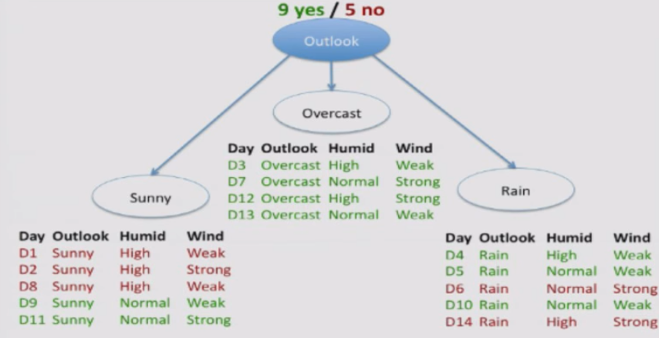
Decision Tree
6
RBEI/EDS1-PJ-AI-S2 | 2018-07-06
© Robert Bosch Engineering and Business Solutions Private Limited 2018. All rights reserved, also regarding any disposal, exploitation, reproduction, editing, distribution, as well as in the event of applications for industrial property rights.

Slide 14
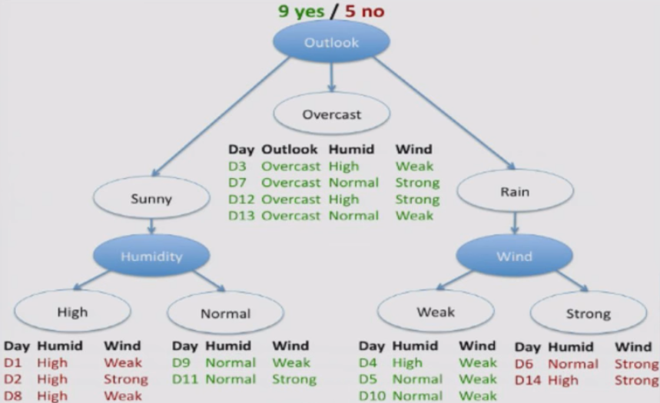
Decision Tree
8
RBEI/EDS1-PJ-AI-S2 | 2018-07-06
© Robert Bosch Engineering and Business Solutions Private Limited 2018. All rights reserved, also regarding any disposal, exploitation, reproduction, editing, distribution, as well as in the event of applications for industrial property rights.

Slide 15
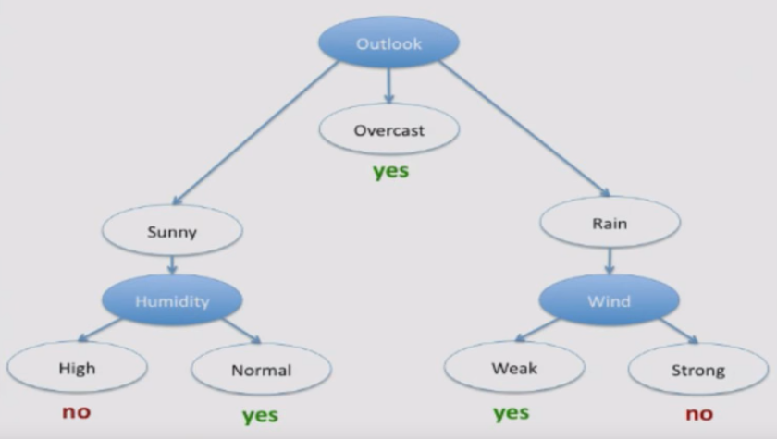
Final Tree
Decision Tree
Set of rules/logical formula
9
RBEI/EDS1-PJ-AI-S2 | 2018-07-06
© Robert Bosch Engineering and Business Solutions Private Limited 2018. All rights reserved, also regarding any disposal, exploitation, reproduction, editing, distribution, as well as in the event of applications for industrial property rights.

Slide 16
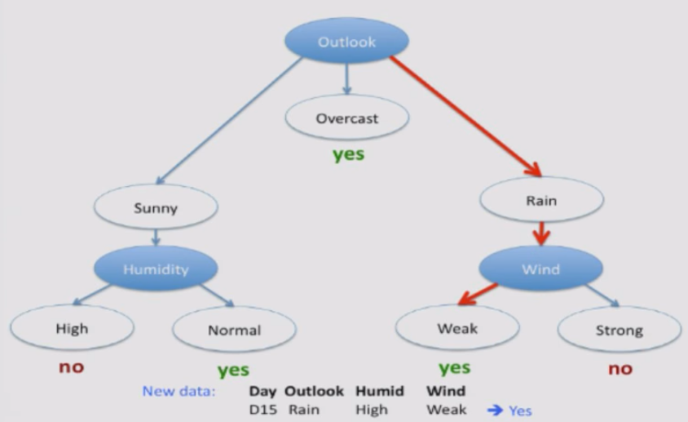
Prediction for New Data
Decision Tree
10
RBEI/EDS1-PJ-AI-S2 | 2018-07-06
© Robert Bosch Engineering and Business Solutions Private Limited 2018. All rights reserved, also regarding any disposal, exploitation, reproduction, editing, distribution, as well as in the event of applications for industrial property rights.

Slide 17
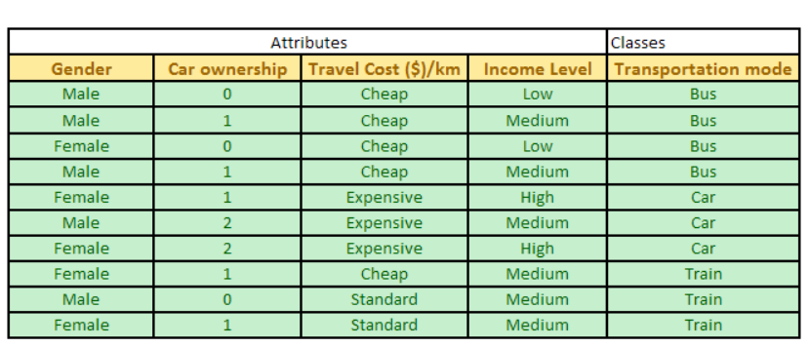
Entropy Calculation
Entropy of Transportation mode
Total =10, Bus=4, Car=3, Train=3
P(Bus)= 0.4, P(car)= 0.3, P(Train)= 0.3
Entropy (Transportation Mode) = -(0.4*log(0.4)+0.3* log(0.3)+ 0.3* log(0.3)) = 1.57

Slide 18
Entropy Calculation
 | Bus | Car | Train | Total
Male | 3 | 1 | 1 | 5
Female | 1 | 2 | 2 | 5
 |  |  |  | 10
Total Transportation data
Entropy of Transportation given Gender E(Transportation| Gender)
E(Transportation|Male) = - ((3/5)*log(3/5)+ (1/5)*log(1/5)+ (1/5)*log(1/5)) = 1.37
E(Transportation|Female)= -((1/5)*log(1/5)+(2/5)*log(2/5)+ (2/5)*log(2/5)) = 1.52
E(Transportation|Gender) = (5/10)* 1.37 +(5/10)*1.52 = 1.445
Information Gain = E(Transportation)- E(Transpotation|Gender) = 1.57- 1.445 = 0.125
Male
Female

Slide 19
Entropy Calculation
 | Bus | Car | Train | Total
Low | 2 | 0 | 0 | 2
Medium | 2 | 1 | 3 | 6
High | 0 | 2 | 0 | 2
Total Transportation data
Entropy of Transportation given Gender E(Transportation| Income)
E(Transportation|Low) = - ((2/2)*log(2/2)+ (0)*log(0)+ (0)*log(0)) = 0
E(Transportation|Medium)= -((2/6)*log(2/6)+(1/6)*log(1/6)+ (3/6)*log(3/6)) = 1.45
E(Transportation|High) = - ((0*log(0)+ (2/2)*log(2/2)+ (0)*log(0)) = 0
E(Transpotation|Income) = (2/10)*0+(6/10)*1.45+ (2/10)*0= 0.87
Information Gain = E(Transportation)- E(Transpotation|Income) = 1.57- 0.87 = 0.69
Low
High
Medium

Slide 20
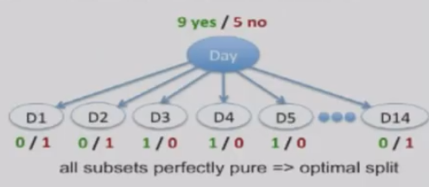
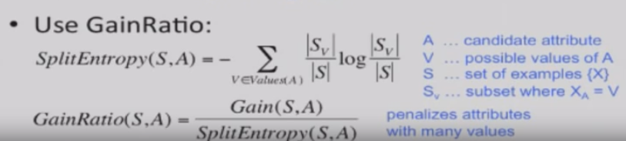
Problem with Information Gain
Decision Tree
Biased towards attributes with many values
Tries to divide into tiny fragments
Use gain ratio
28
RBEI/EDS1-PJ-AI-S2 | 2018-07-06
© Robert Bosch Engineering and Business Solutions Private Limited 2018. All rights reserved, also regarding any disposal, exploitation, reproduction, editing, distribution, as well as in the event of applications for industrial property rights.

Slide 21
Gain Ratio
Gain Ratio is an alternative to Information Gain that is used to select the attribute for splitting in a decision tree. It is used to overcome the problem of bias towards the attribute with many outcomes.
Gain Ratio is a measure that takes into account both the information gain and the number of outcomes of a feature to determine the best feature to split on.
Gain Ratio = Information Gain / Split Info
Split Info = Entropy Within the X variable
Note — The lower the value of Split Info, the better the split is considered to be.

Slide 22
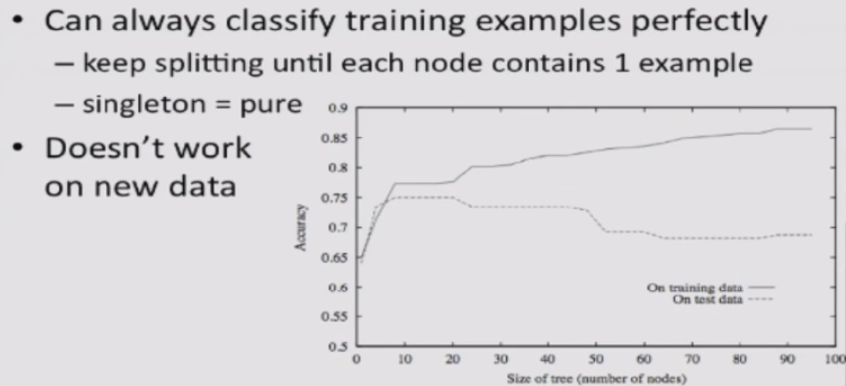
Overfitting in Decision Trees
Decision Tree
Decision tree is recursive algorithm, it will keep splitting the data until it ends up with all pure nodes
Tree is becoming specific for training data and cannot generalize for new data
26
RBEI/EDS1-PJ-AI-S2 | 2018-07-06
© Robert Bosch Engineering and Business Solutions Private Limited 2018. All rights reserved, also regarding any disposal, exploitation, reproduction, editing, distribution, as well as in the event of applications for industrial property rights.

Slide 23
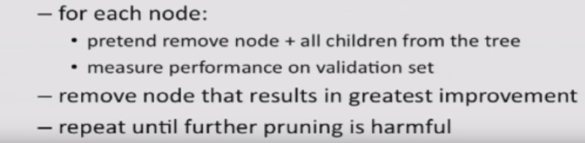
To Avoid Overfitting
Decision Tree
Stop Splitting when further split is not statistically significant, put the threshold
Grow the tree to full depth and do the pruning
Divide the data into training and validation
27
RBEI/EDS1-PJ-AI-S2 | 2018-07-06
© Robert Bosch Engineering and Business Solutions Private Limited 2018. All rights reserved, also regarding any disposal, exploitation, reproduction, editing, distribution, as well as in the event of applications for industrial property rights.

Slide 24
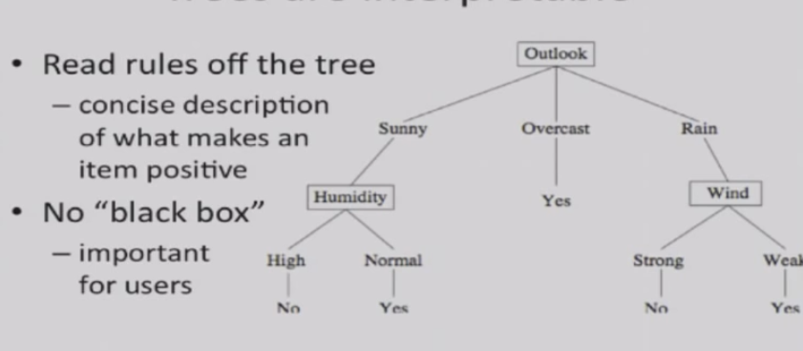

Trees are interpretable
Decision Tree
29
RBEI/EDS1-PJ-AI-S2 | 2018-07-06
© Robert Bosch Engineering and Business Solutions Private Limited 2018. All rights reserved, also regarding any disposal, exploitation, reproduction, editing, distribution, as well as in the event of applications for industrial property rights.

Slide 25
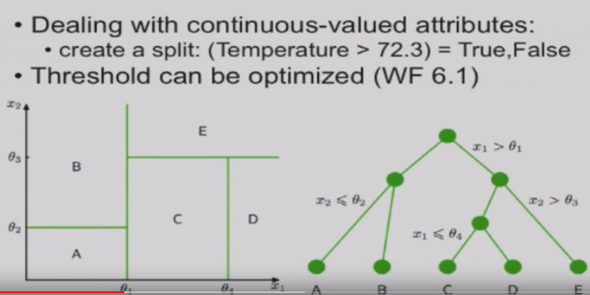
Continuous attributes
Decision Tree
30
RBEI/EDS1-PJ-AI-S2 | 2018-07-06
© Robert Bosch Engineering and Business Solutions Private Limited 2018. All rights reserved, also regarding any disposal, exploitation, reproduction, editing, distribution, as well as in the event of applications for industrial property rights.

Slide 26


Advantages
Decision Tree
Simple to understand and to interpret. Trees can be visualized.
More easily deal with non-linear relationships, correlated variables, multicollinearity
Able to handle both numerical and categorical data.
Able to handle multi-output problems.
Easy to handle with irrelevant features
Requires little data preparation. Other techniques often require data normalization.
The cost of using the tree (i.e., predicting data) is logarithmic in the number of data points used to train the tree. O( Depth)
In general, the run time cost to construct a balanced binary tree is
and query time .
32
RBEI/EDS1-PJ-AI-S2 | 2018-07-06
© Robert Bosch Engineering and Business Solutions Private Limited 2018. All rights reserved, also regarding any disposal, exploitation, reproduction, editing, distribution, as well as in the event of applications for industrial property rights.

Slide 27
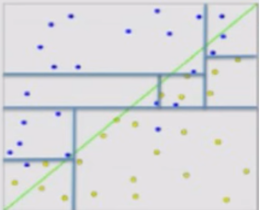
Disadvantages
Decision Tree
Only Axis-aligned split of data
Algorithm is “greedy” in the sense that at each node it finds the best local choice without awareness of a global optimum
Sensitive to the scoring rule
Decision-tree can create over-complex trees that do not generalize the data well i.e. overfitting. Mechanisms such as pruning, setting the minimum number of samples required at a leaf node or setting the maximum depth of the tree to avoid this problem.
Decision trees can be unstable with small variations in the data and might result in a completely different tree. This can be mitigated by using ensemble of decision trees.
Decision tree can create biased trees if some target classes dominate. It is therefore recommended to have balanced class data prior to fitting.
32
RBEI/EDS1-PJ-AI-S2 | 2018-07-06
© Robert Bosch Engineering and Business Solutions Private Limited 2018. All rights reserved, also regarding any disposal, exploitation, reproduction, editing, distribution, as well as in the event of applications for industrial property rights.

Slide 28
Step 1: Categorical columns in to dummy Columns
Decision Tree Code
OUTLOOK | TEMPERATURE
Rainy | Hot
Rainy | Hot
Overcast | Hot
Sunny | Cool
Sunny | Cool
RAINY | OVERCAST | SUNNY | HOT | COOL
1 | 0 | 0 | 1 | 0
1 | 0 | 0 | 1 | 0
0 | 1 | 0 | 1 | 0
0 | 0 | 1 | 0 | 1
0 | 0 | 1 | 0 | 1
These approaches are as follows:
Using the LabelBinarizer from sklearn
Using BinaryEncoder from category_encoders
Using the get_dummies() function of the pandas library
32
RBEI/EDS1-PJ-AI-S2 | 2018-07-06
© Robert Bosch Engineering and Business Solutions Private Limited 2018. All rights reserved, also regarding any disposal, exploitation, reproduction, editing, distribution, as well as in the event of applications for industrial property rights.

Slide 29
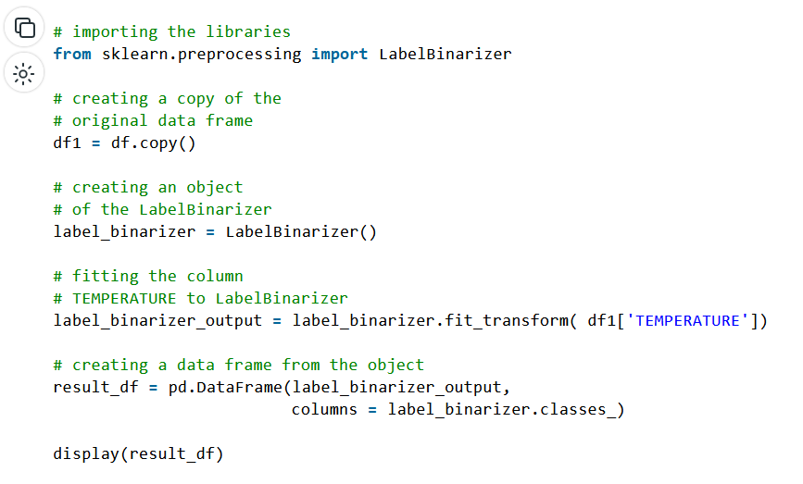

Slide 30
Tree algorithms: ID3, C4.5, C5.0 and CART
Decision Tree
ID3 (Iterative Dichotomiser 3) was developed in 1986 by Ross Quinlan. The algorithm creates a multiway tree, finding for each node (i.e. in a greedy manner) the categorical feature that will yield the largest information gain for categorical targets. Trees are grown to their maximum size and then a pruning step is usually applied to improve the ability of the tree to generalize to unseen data.
C4.5 is the successor to ID3 and removed the restriction that features must be categorical by dynamically defining a discrete attribute (based on numerical variables) that partitions the continuous attribute value into a discrete set of intervals.
C5.0 is Quinlan’s latest version release under a proprietary license. It uses less memory and builds smaller rulesets than C4.5 while being more accurate.
CART (Classification and Regression Trees) is very similar to C4.5, but it differs in that it supports numerical target variables (regression) and does not compute rule sets. CART constructs binary trees using the feature and threshold that yield the largest information gain at each node.
scikit-learn uses an optimized version of the CART algorithm; however, the scikit-learn implementation does not support categorical variables for now. Need to convert into numeric by dummy coding
32
RBEI/EDS1-PJ-AI-S2 | 2018-07-06
© Robert Bosch Engineering and Business Solutions Private Limited 2018. All rights reserved, also regarding any disposal, exploitation, reproduction, editing, distribution, as well as in the event of applications for industrial property rights.

Slide 31
Hyper Parameter Tuning
Decision Tree
Hyperparameter tuning is searching the hyperparameter space for a set of values that will optimize model architecture.
Hyperparameter tuning is also tricky in the sense that there is no direct way to calculate how a change in the hyperparameter value will reduce the loss of your model, so we usually resort to experimentation.
We define the range of values is to use a hyperparameter tuning method, the most common and expensive being Grid Search where others like Random Search and Bayesian Optimization will provide a “smarter”, less expensive tuning.
how to tune a Decision Tree. What should be the range of values I should try for the maximum depth, what should be the minimum number of samples required at a leaf node?
Since the decision tree is primarily a classification model, we will be looking into the decision tree classifier.
32
RBEI/EDS1-PJ-AI-S2 | 2018-07-06
© Robert Bosch Engineering and Business Solutions Private Limited 2018. All rights reserved, also regarding any disposal, exploitation, reproduction, editing, distribution, as well as in the event of applications for industrial property rights.

Slide 32
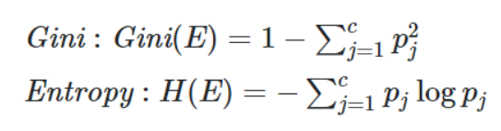
Hyper Parameter Tuning
Decision Tree
criterion: string, optional (default=”gini”):
The function to measure the quality of a split. Supported criteria are “gini” for the Gini impurity and “entropy” for the information gain.
We can pretty much use either, but the only difference is entropy might be a little slower to compute because it requires you to compute a logarithmic function:
Many of the researchers point out that, the choice of splitting criteria will not make much difference in the tree performance.
32
RBEI/EDS1-PJ-AI-S2 | 2018-07-06
© Robert Bosch Engineering and Business Solutions Private Limited 2018. All rights reserved, also regarding any disposal, exploitation, reproduction, editing, distribution, as well as in the event of applications for industrial property rights.

Slide 33
Hyper Parameter Tuning
Decision Tree
splitter: string, optional (default=”best”)
The strategy used to choose the split at each node. Supported strategies are “best” to choose the best split and “random” to choose the best random split.
Let’s say you have hundreds of features, then “best” splitter would be ideal because it will calculate the best features to split based on the impurity measure and use that to split the nodes, whereas if you choose “random” you have a high chance of ending up with features that don’t really give you that much information, which would lead to a more deeper less precise tree.
On the other hand, the “random” splitter has some advantages, specifically, since it selects a set of features randomly and splits, it doesn’t have the computational overhead of computing the optimal split. Next, it is also less prone to overfitting because you are not essentially calculating the best split before each split and the additional randomness will help you here, so if your model is overfitting, then you can change the splitter to “random” and retrain.
So, for a tree with few features without any overfitting, we would go with the “best” splitter to be safe to get best possible model architecture.
32
RBEI/EDS1-PJ-AI-S2 | 2018-07-06
© Robert Bosch Engineering and Business Solutions Private Limited 2018. All rights reserved, also regarding any disposal, exploitation, reproduction, editing, distribution, as well as in the event of applications for industrial property rights.

Slide 34
Hyper Parameter Tuning
Decision Tree
max_features: int, float, string or None, optional (default=None)
The number of features to consider when looking for the best split:
If int, then consider max_features features at each split.
If float, then max_features is a fraction and int(max_features * n_features) features are considered at each split.
If “auto”, then max_features=sqrt(n_features).
If “sqrt”, then max_features=sqrt(n_features).
If “log2”, then max_features=log2(n_features).
If None, then max_features=n_features.
Every time there is a split, your algorithm looks at a number of features and takes the one with the optimal metric using gini impurity or entropy, and creates two branches according to that feature.
It is computationally heavy to look at all the features every single time, so you can just check some of them using the various max_features options.
32
RBEI/EDS1-PJ-AI-S2 | 2018-07-06
© Robert Bosch Engineering and Business Solutions Private Limited 2018. All rights reserved, also regarding any disposal, exploitation, reproduction, editing, distribution, as well as in the event of applications for industrial property rights.

Slide 35
Hyper Parameter Tuning
Decision Tree
max_depth: int or None, optional (default=None)
The maximum depth of the tree. If None, then nodes are expanded until all leaves are pure or until all leaves contain less than min_samples_split samples.
The theoretical maximum depth a decision tree can achieve is one less than the number of training samples, but no algorithm will let you reach this point for obvious reasons, one big reason being overfitting. Note here that it is the number of training samples and not the number of features because the data can be split on the same feature multiple times.
If you don’t specify a depth for the tree, scikit-learn will expand the nodes until all leaves are pure, meaning the leaf might have only one label class if default for the min_samples_leaf, is one.
most of these hyperparameters are tied to one another.
let the model decide the max_depth first and then compare train and test scores for overfitting or underfitting and depending on the degree decrease or increase the max_depth.
32
RBEI/EDS1-PJ-AI-S2 | 2018-07-06
© Robert Bosch Engineering and Business Solutions Private Limited 2018. All rights reserved, also regarding any disposal, exploitation, reproduction, editing, distribution, as well as in the event of applications for industrial property rights.

Slide 36
Hyper Parameter Tuning
Decision Tree
min_samples_leaf: int, float, optional (default=1)
The minimum number of samples required to be at a leaf node. A split point at any depth will only be considered if it leaves at least min_samples_leaf training samples in each of the left and right branches. This may have the effect of smoothing the model, especially in regression.
If int, then consider min_samples_leaf as the minimum number.
If float, then min_samples_leaf is a fraction and ceil(min_samples_leaf * n_samples) are the minimum number of samples for each node.
Similar to min_samples_split, min_samples_leaf is also used to control over-fitting by defining that each leaf has more than one element. Thus ensuring that the tree cannot overfit the training dataset by creating a bunch of small branches exclusively for one sample each.
An empirical study on hyperparameter tuning of decision trees also states that the ideal min_samples_leaf values tend to be between 1 to 20 for the CART algorithm. This paper also indicates that min_samples_split and min_samples_leaf are the most responsible for the performance of the final trees
one exception to this is when you have an imbalanced class problem because then the regions in which the minority class will be in majority will be very small so you should go with a lower value.
32
RBEI/EDS1-PJ-AI-S2 | 2018-07-06
© Robert Bosch Engineering and Business Solutions Private Limited 2018. All rights reserved, also regarding any disposal, exploitation, reproduction, editing, distribution, as well as in the event of applications for industrial property rights.

Slide 37
Hyper Parameter Tuning
Decision Tree
class_weight: dict, list of dicts, “balanced” or None, default=None
Weights associated with classes in the form {class_label: weight}. If not given, all classes are supposed to have weight one. For multi-output problems, a list of dicts can be provided in the same order as the columns of y.
This can be highly useful when you have an imbalanced dataset. Usually, you can just start with the distribution of your classes as the class weights and then depending on where your decision tree lean, you can try to increase or decrease the other class weights so that the algorithm penalizes samples of one class relative to the other.
Note that this isn’t like an under sampling or oversampling technique, the number of samples in a class doesn’t actually change, its the weight assigned to it
weight * (the number of samples from a class in the node) / (size of class)
32
RBEI/EDS1-PJ-AI-S2 | 2018-07-06
© Robert Bosch Engineering and Business Solutions Private Limited 2018. All rights reserved, also regarding any disposal, exploitation, reproduction, editing, distribution, as well as in the event of applications for industrial property rights.

Slide 38
Hyper Parameter Tuning
Decision Tree
min_impurity_decrease: float, optional (default=0.)
A node will be split if this split induces a decrease of the impurity greater than or equal to this value.
We can increase the min_impurity_decrease to prevent further division because now, the node will not be further split if the impurity doesn’t decrease by the amount you specified.
Note that this will affect your whole tree, so, you have to experiment with the numbers but the above explanation should give you a starting point.
32
RBEI/EDS1-PJ-AI-S2 | 2018-07-06
© Robert Bosch Engineering and Business Solutions Private Limited 2018. All rights reserved, also regarding any disposal, exploitation, reproduction, editing, distribution, as well as in the event of applications for industrial property rights.

Slide 39
Hyper Parameter Tuning
Decision Tree
random_state: int, RandomState instance or None, optional (default=None)
random_state is not really a hyperparameter to tune
The most straightforward answer is so you can get consistent results, well somewhat because remember splitter, it will introduce some randomness to your results so if you rerun your decision tree, your results will be different, but it should not be too different.
Set a random_state and tune your other parameters so that you don’t get stuck in local minima than play around with the random_state.
32
RBEI/EDS1-PJ-AI-S2 | 2018-07-06
© Robert Bosch Engineering and Business Solutions Private Limited 2018. All rights reserved, also regarding any disposal, exploitation, reproduction, editing, distribution, as well as in the event of applications for industrial property rights.

Slide 40
Summary
Decision Tree
The Decision tree complexity has a crucial effect on its accuracy and it is explicitly controlled by the stopping criteria used and the pruning method employed.
Usually, the tree complexity is measured by one of the following metrics: the total number of nodes, total number of leaves, tree depth and number of attributes used, max_depth, min_samples_split, and min_samples_leaf are all stopping criteria
whereas min_weight_fraction_leaf and min_impurity_decrease are pruning methods.
Pruning is a tradeoff between accuracy and generalizability, so your train scores might lower but the difference between train and test scores will also get lower.
Fixing the depth, min_samples_split and class_weight are important to get best model
At last, we can further prune the tree using min_impurity_decrease parameter
32
RBEI/EDS1-PJ-AI-S2 | 2018-07-06
© Robert Bosch Engineering and Business Solutions Private Limited 2018. All rights reserved, also regarding any disposal, exploitation, reproduction, editing, distribution, as well as in the event of applications for industrial property rights.

Slide 41
Tips on practical use
Decision Tree
Decision trees tend to overfit on data with a large number of features. Getting the right ratio of samples to number of features is important, since a tree with few samples in high dimensional space is very likely to overfit.
Consider performing dimensionality reduction (PCA, ICA, or Feature selection) beforehand to give your tree a better chance of finding features that are discriminative if large number of features present.
Visualize your tree as you are training by using the export function. Use max_depth=3 as an initial tree depth to get a feel for how the tree is fitting to your data, and then increase the depth.
Use min_samples_split or min_samples_leaf to ensure that multiple samples inform every decision in the tree, by controlling which splits will be considered. A very small number will usually mean the tree will overfit, whereas a large number will prevent the tree from learning the data. Try min_samples_leaf=5 as an initial value. If the sample size varies greatly, a float number can be used as percentage in these two parameters.
In Decision Trees, we need not remove highly correlated variables as nodes are divided into sub-nodes using one independent variable only, hence even if two or more variables are highly correlated, the variable producing the highest information gain will be used for the analysis.
32
RBEI/EDS1-PJ-AI-S2 | 2018-07-06
© Robert Bosch Engineering and Business Solutions Private Limited 2018. All rights reserved, also regarding any disposal, exploitation, reproduction, editing, distribution, as well as in the event of applications for industrial property rights.

Slide 42
Decision Tree is not Best Option
Although decision trees can handle both categorical and continuous features, they tend to become quite large when dealing with continuous descriptive features. This can result in trees becoming difficult to interpret.
Consequently, if dealing with purely continuous data, other prediction models may be more appropriate for example, the error-based models
Decision trees also have difficulty with domains that have a large number of descriptive features, particularly if the number of instances in the training dataset is small. Probability based model will be better

Slide 43
Model Ensembles
Rather than creating a single model, generate multiple models and then aggregate the prediction outputs.
The motivation behind using ensemble methods is the idea that a committee of experts working together on a problem are more likely to solve it successfully than a single expert working alone.
Given a large population of independent models, an ensemble can be very accurate even if the individual models in the ensemble perform only marginally better than random guessing

Slide 44
Model Ensembles
There are two defining characteristics of ensemble models:
They build multiple different models from the same dataset by inducing each model using a modified version of the dataset.
They make a prediction by aggregating the predictions of the different models in the ensemble.
For categorical target features, this can be done using different types of voting mechanisms, and
for continuous target features, this can be done using a measure of the central tendency of the different model predictions, such as the mean or the median.
There are two standard approaches to creating ensembles: boosting and bagging.

Slide 45
Boosting
When we use boosting, each new model added to an ensemble is biased to pay more attention to instances that previous models misclassified.
Boosted ensembles are prone to overfitting, and in domains with large numbers of features, overfitting becomes a serious problem

Slide 46
Bagging
When we use bagging (or bootstrap aggregating), each model in the ensemble is trained on a random samples of the dataset where, importantly, each random sample is the same size as the dataset and sampling with replacement is used.
These random samples are known as bootstrap samples, and one model is induced from each bootstrap sample.
The reason that we sample with replacement is that this will result in duplicates within each of the bootstrap samples, and consequently, every bootstrap sample will be missing some of the instances from the dataset.
It means training data for each model will be different

Slide 47
Bagging
Decision tree algorithms are well suited to use with bagging. This is because decision trees are very sensitive to changes in the dataset: a small change in the dataset can result in a different feature being selected to split the dataset.
when bagging is used with decision trees, the sampling process is extended so that each bootstrap sample only uses a randomly selected subset of the features in the dataset. It is called Subspace sampling.
Subspace sampling further encourages the diversity of the trees within the ensemble and has the advantage of reducing the training time for each tree.
Bagging is simpler to implement and parallelize than boosting, so it may be better with respect to ease of use and training time.

Slide 48
Random Forest
The combination of bagging, subspace sampling, and decision trees is known as a random forest model.
Once the individual models have been induced, the ensemble makes predictions by returning the majority vote or the median depending on the type of prediction required.
For continuous target features, the median is preferred to the mean because the mean is more heavily affected by outliers.

Slide 49
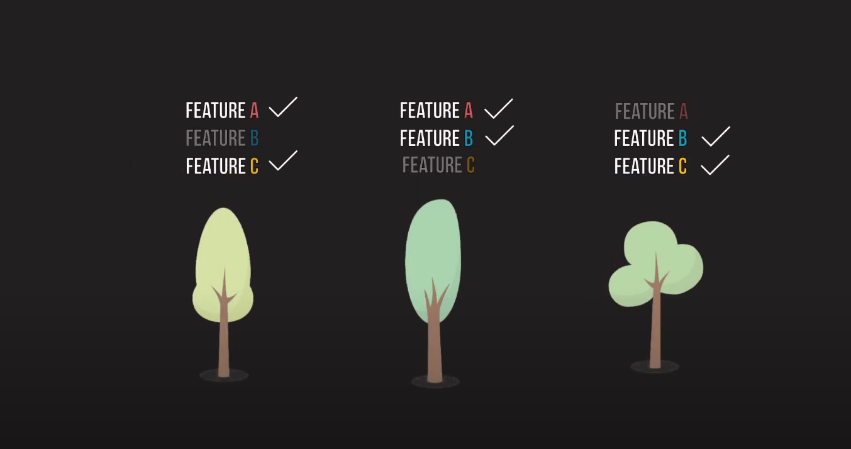
Random Forest
Random forests are supervised machine learning models that train multiple decision trees and integrate the results by averaging them.
This general practice of combining the results of many models is called “Emsembling technique”, or very famously said, “Wisdom of the crowd”.

Slide 50
from sklearn.ensemble import RandomForestClassifier
model3 = RandomForestClassifier(random_state = 24, n_jobs = -1)
model3.fit(train_inputs, train_targets)

Slide 51
Hyperparameter Tuning
n_estimators
This argument limits the number of decision trees in random forests.
max_features
Each time a split occurs, the model will only consider a fraction of columns. This will help to generalize our random forest model. If every time, all the features are considered at all splits, the random forest model will contain identical trees.

Slide 52
Hyperparameter Tuning
min_samples_split : Minimum number of sample required at node for further splitting
min_samples_leaf : minimum number of samples required to be left at the leaf node.
min_impurity_decrease
This argument is used to supervise the threshold for splitting nodes, i.e., a split will only take place if it reduces the Gini Impurity, greater than or equal to the min_impurity_decrease value.

Slide 53
Bootstrap
By default, Random Forest does not use the whole dataset for fitting each decision tree. Instead, while creating decision trees, random rows of the dataset are selected consecutively, i.e., while training, some rows may not show up at all, whereas some might show up twice. This random picking is done for the entire dataset.
You can change default=False to disable it. In that case, the entire dataset will be used to create decision trees.

Slide 54
HyperParmeter Tuning
https://towardsdatascience.com/how-to-tune-a-decision-tree-f03721801680
https://www.youtube.com/watch?v=gJo0uNL-5Qw
https://www.youtube.com/watch?v=HdlDYng8g9s&t=14s

Slide 55
Useful links
Decision Tree
https://www.youtube.com/watch?v=A-iqpbz7IDE&list=PLBv09BD7ez_4temBw7vLA19p3tdQH6FYO&index=8
https://www.kdnuggets.com/2020/01/decision-tree-algorithm-explained.html
https://scikit-learn.org/stable/modules/tree.html
http://people.revoledu.com/kardi/tutorial/DecisionTree/how-to-measure-impurity.htm
In R
https://www.guru99.com/r-decision-trees.html
https://www.casact.org/community/affiliates/canw/0917/Murphy.pdf
https://cran.r-project.org/web/packages/rpart/vignettes/longintro.pdf
https://www.statmethods.net/advstats/cart.html
http://dataaspirant.com/2017/02/03/decision-tree-classifier-implementation-in-r/
https://www.analyticsvidhya.com/blog/2016/04/complete-tutorial-tree-based-modeling-scratch-in-python/
33
RBEI/EDS1-PJ-AI-S2 | 2018-07-06
© Robert Bosch Engineering and Business Solutions Private Limited 2018. All rights reserved, also regarding any disposal, exploitation, reproduction, editing, distribution, as well as in the event of applications for industrial property rights.

Slide 56
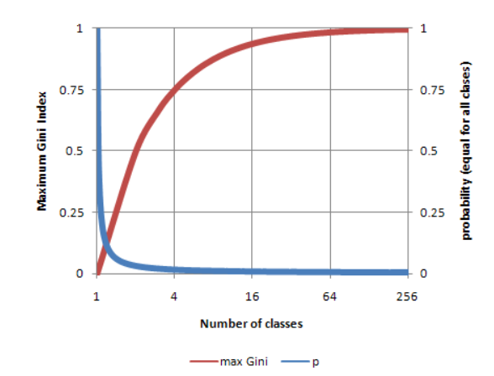
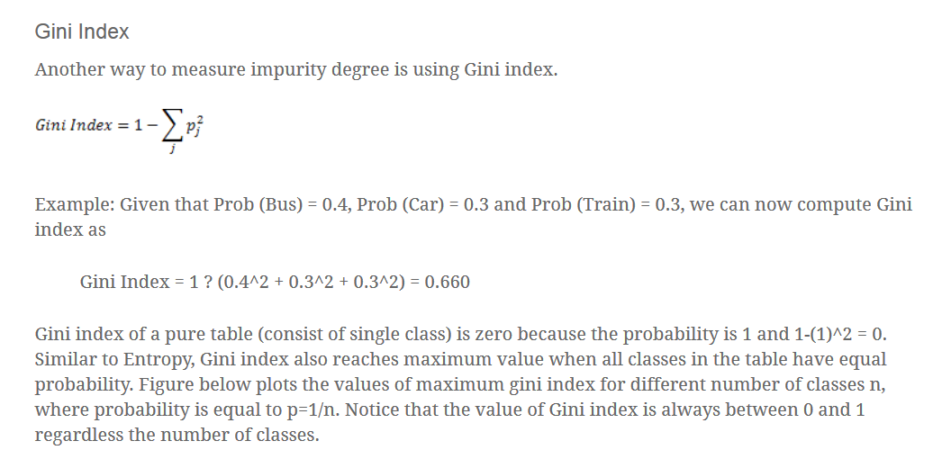
Decision Tree
17
RBEI/EDS1-PJ-AI-S2 | 2018-07-06
© Robert Bosch Engineering and Business Solutions Private Limited 2018. All rights reserved, also regarding any disposal, exploitation, reproduction, editing, distribution, as well as in the event of applications for industrial property rights.

Slide 57
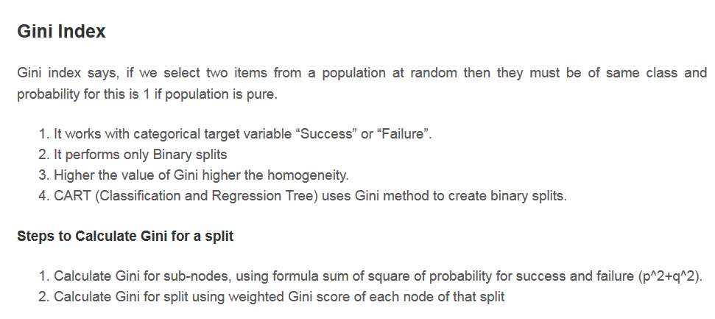
Decision Tree
18
RBEI/EDS1-PJ-AI-S2 | 2018-07-06
© Robert Bosch Engineering and Business Solutions Private Limited 2018. All rights reserved, also regarding any disposal, exploitation, reproduction, editing, distribution, as well as in the event of applications for industrial property rights.

Slide 58
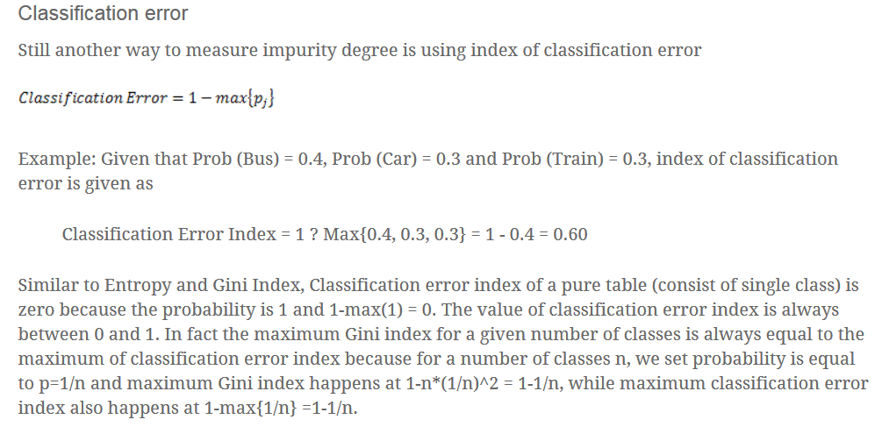
Decision Tree
19
RBEI/EDS1-PJ-AI-S2 | 2018-07-06
© Robert Bosch Engineering and Business Solutions Private Limited 2018. All rights reserved, also regarding any disposal, exploitation, reproduction, editing, distribution, as well as in the event of applications for industrial property rights.

Slide 59
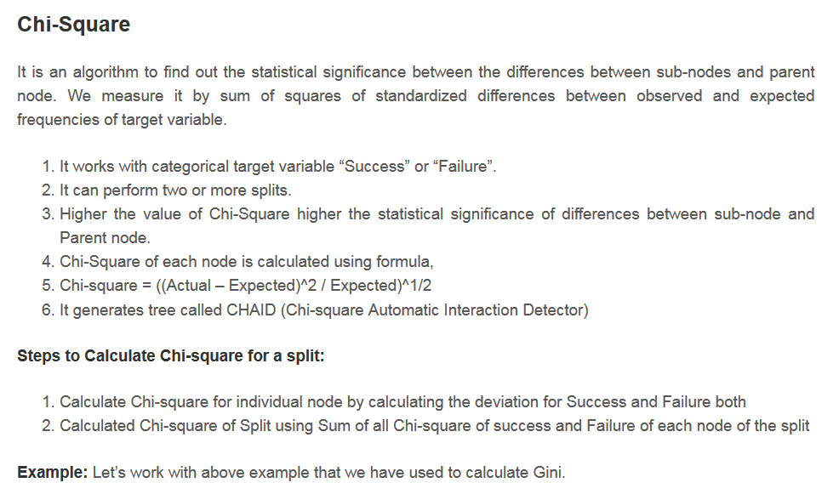
.llllldwq 234567890-]
Decision Tree
20
RBEI/EDS1-PJ-AI-S2 | 2018-07-06
© Robert Bosch Engineering and Business Solutions Private Limited 2018. All rights reserved, also regarding any disposal, exploitation, reproduction, editing, distribution, as well as in the event of applications for industrial property rights.

Slide 60
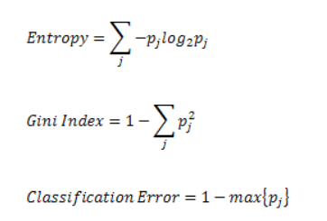
How to measure Impurity?
Decision Tree
Entropy is measure of impurity of data. Entropy for Pure sample should be zero and also zero for class whose probability is 0.
14
RBEI/EDS1-PJ-AI-S2 | 2018-07-06
© Robert Bosch Engineering and Business Solutions Private Limited 2018. All rights reserved, also regarding any disposal, exploitation, reproduction, editing, distribution, as well as in the event of applications for industrial property rights.

